Slide 1
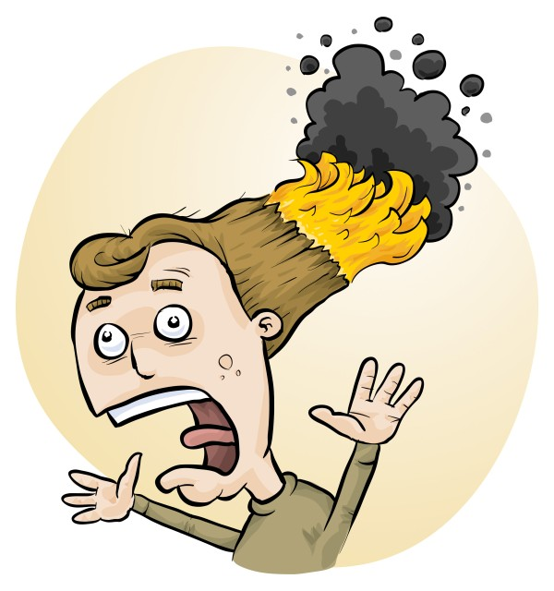
Improve safety and save time with RiskAssess
Phillip and Eva Crisp

Slide 2
• reduce injuries • increase legal protection
Why do risk assessments?

Slide 3
Work Health & Safety Act 2020
. . . a duty . . . to eliminate/minimise risks to health and safety as far as is reasonably practicable.
. . . taking into account and weighing up all relevant matters including: (a) the likelihood of the hazard or the risk concerned occurring; and (b) the degree of harm that might result from the hazard or the risk . . . .
Part 2, Sections 17 and 18

Slide 4
all relevant matters includes
facilities available
behaviour of the class
students with special needs
students with allergies
• . . . . . . . .
(NOT book “risk assessment”, tick sheet, etc)
likelihood
degree of harm consideration requires
proper risk assessment using a risk matrix
e.g. Aust/ISO Standard on Risk Management

Slide 5
Issues
facilities available
behaviour of the class
students with special needs
students with allergies
. . . . . . . .
Issues may, and commonly will,
differ from class to class.
No one hat fits all!

Slide 6
What is RiskAssess?
• web-based risk assessment tool
• customised to the school situation
• provides - electronic templates (AU/ISO) - databases of information on risks
• easy sharing of risk assessments
• plus ordering, scheduling & labelling

Slide 7
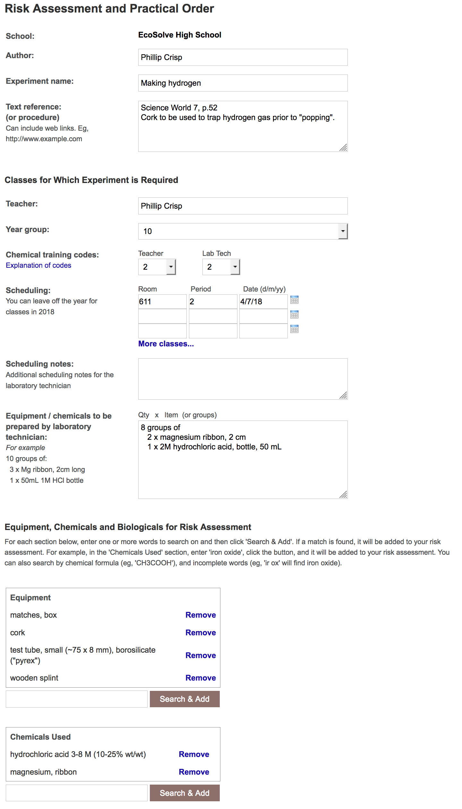
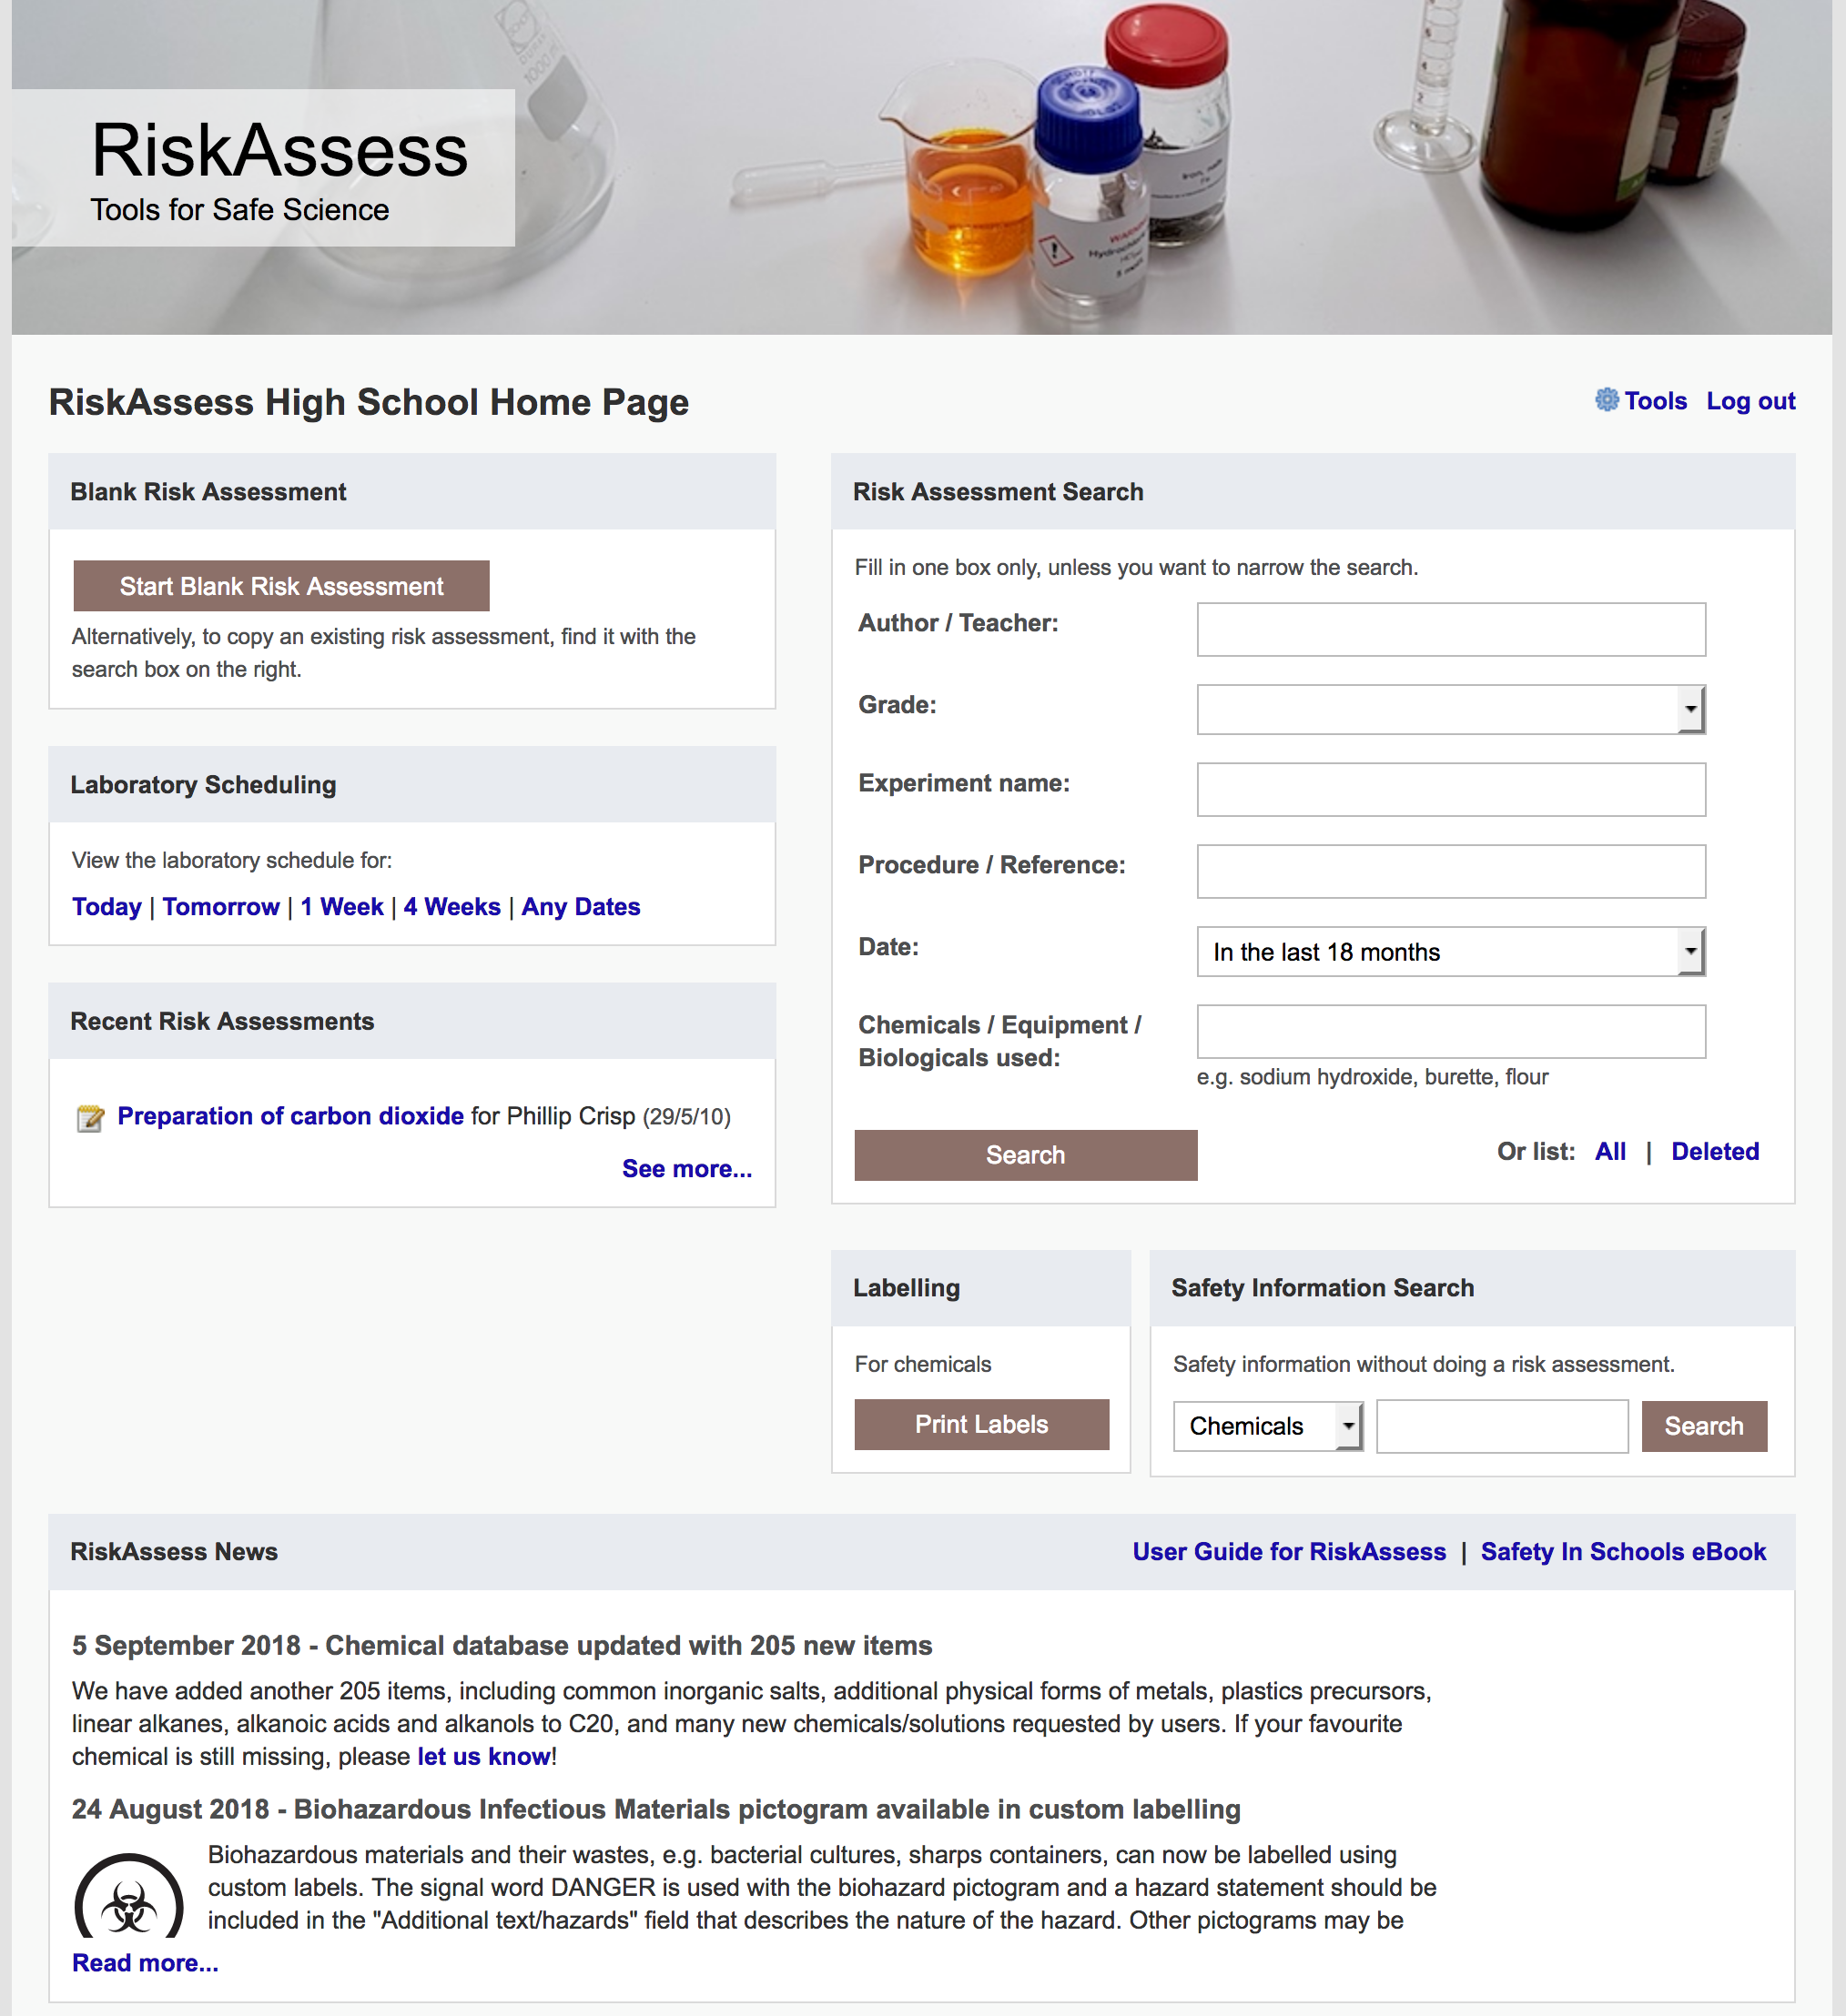

Slide 8
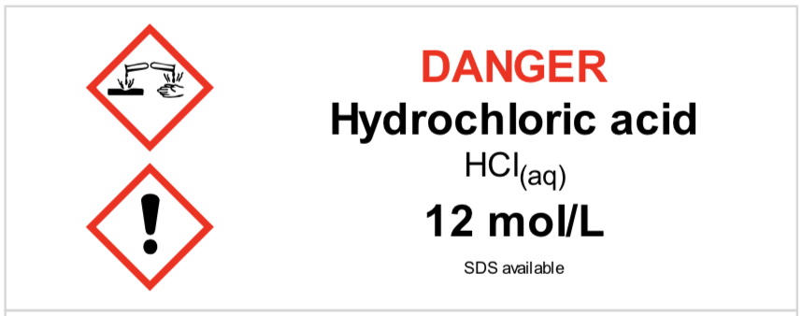
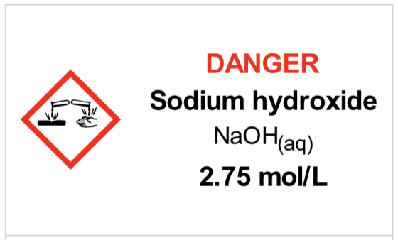
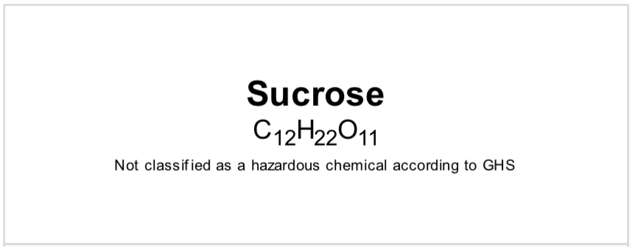
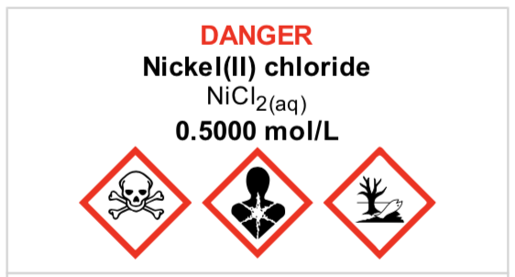
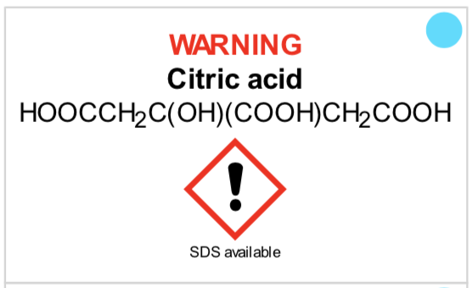
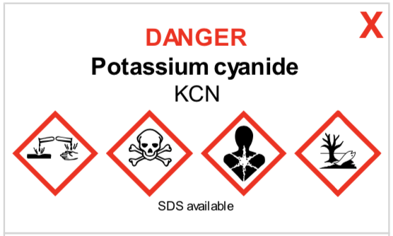
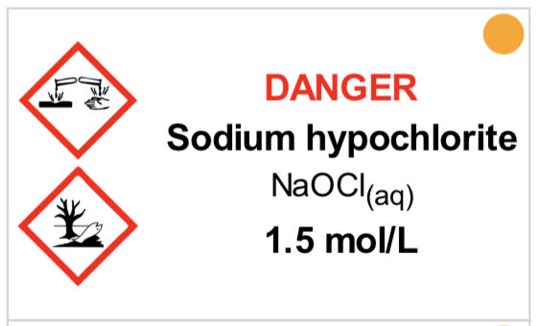
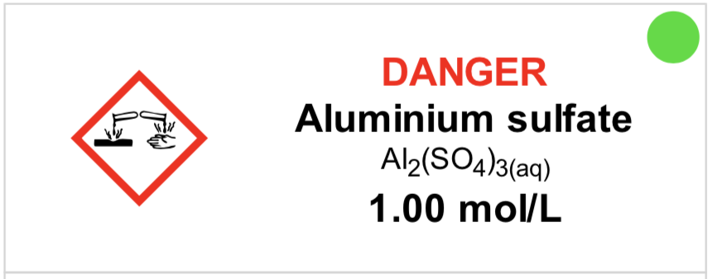
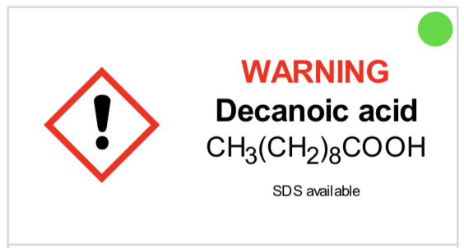
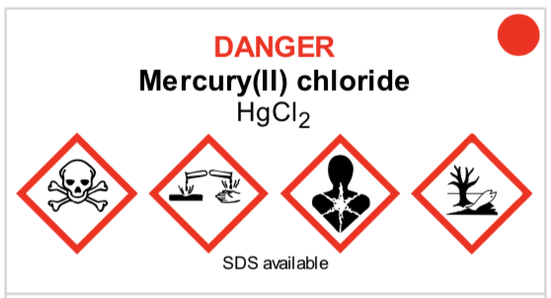
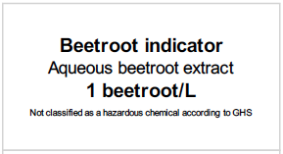
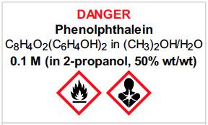

Slide 9
Logic
• separate sections for teacher and lab technician
• initial assessment of inherent risk - if low, go to end - if medium or more, record control measures - if high or extreme, third reviewer required
• cross-checking by teacher/tech/reviewer
• scheduling, ordering, labelling to save time
• inexpensive ($350+GST per campus per year)

Slide 10
Electronic system
• relatively rapid
• prompts sensitive to context
• reduces paper consumption
• easy to review and update
• search and statistics
• long term storage
• demonstrated to work in schools
RiskAssess: 2,700 schools AU+NZ+CA
85% AU, 25% WA
6,500,000 risk assessments

Slide 11
Details
• access from school/home
• nothing to install on computer, tablet or phone (instant update)
• unlimited number of simultaneous users and risk assessments
• minimal data entry
• complements SDSs
• continuing input from science staff
• multiple backups of data & backup server
• support and advice

Slide 12
DEMO

Slide 13
Advantages of RiskAssess
proper consideration of risks and control measures
standardisation
storage of records for legal purposes
communication between teachers and lab technicians
saves time due to scheduling, labelling, info
saves money with disposal information
discourages spur-of-the-moment experiments
useful for new/inexperienced staff

Slide 14
Not just risk assessment!
• scheduling system
• prac ordering
• GHS labelling - standard - custom
• disposal advice
• learning resources
And an exciting video . . .
“Getting Started with RiskAssess”
starring Phillip and Eva!

Slide 15
Outcomes
• reduced frequency of injuries - to students - to school staff
• reduced costs for paperwork, litigation and payouts
• compliance with the law
• easy ordering, scheduling and labelling
• helps maintain variety of chemicals and equipment

Slide 16
2700 schools WA: 84 (25%)
590 schools WA: 2
200 schools
WA: 0
80 schools WA: 0

Slide 17
Questions?

